Slide 1
Widgets and Layouts
STW300CEM Android Applications Development

Slide 2
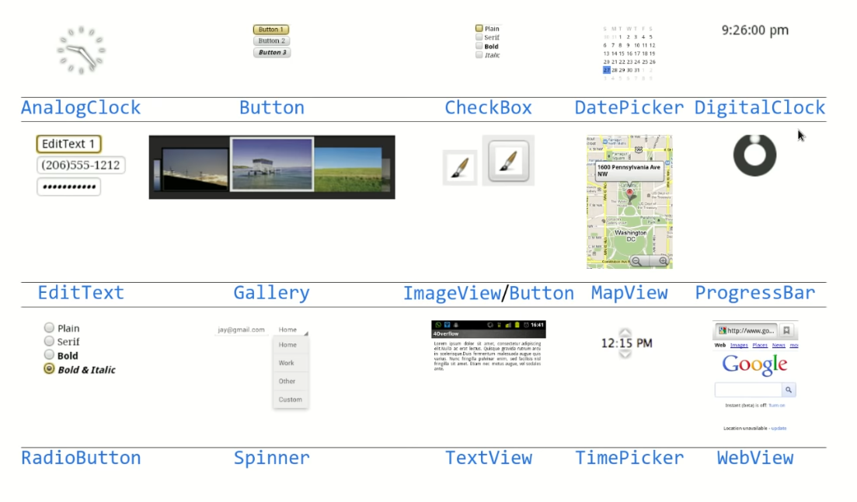
Android Widgets

Slide 3
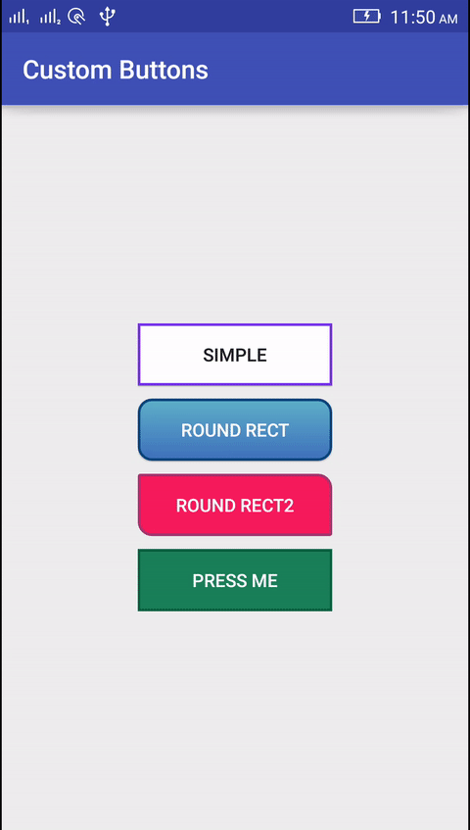
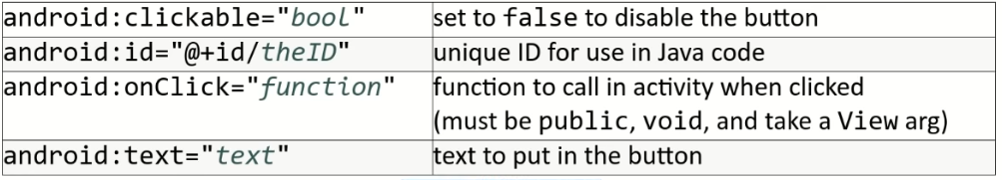
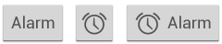
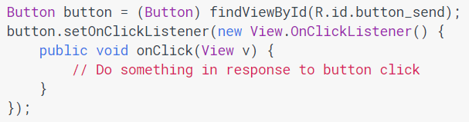
Button
A clickable widget with a text label.
Key attributes in XML
Java Code

Slide 4
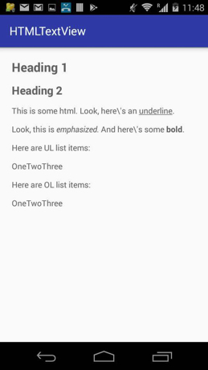
TextView
A TextView displays text to the user and optionally allows them to edit it. A TextView is a complete text editor, however the basic class is configured to not allow editing.
Key attributes in XML
Java Code

Slide 5
Sizing and positioning
How does the programmer specify where each component appear, how big each component should be , etc. ?
Absolute positioning (C++ , C# , others) :
- Programmer specify where the component will appear.
- “Put this button at (x=15,y=20) and make it 70 X 30 px in size”.
Layout managers (Java, Android) :
- Objects that decide where to position each component based on some general rules or criteria.
- “ Put these four buttons into 2 X 2 grid and put these text boxes in a horizontal flow in south part of the app”
- More flexible and general; works better with a variety of device.

Slide 6
ViewGroup as layout
ViewGroup superclass represent containers of views
- layouts are described in XML and mirrored in java code.
- Android provides several pre-existing layout managers; you can define your own custom layouts if needed.
- layouts can be nested to achieve combinations of features.
In the java code and XML :
- an Activity is a ViewGroup.
- various Layout class are also ViewGroups
- widgets can be added to ViewGroup , which will then manage that widget’s positions/size behavior.

Slide 7
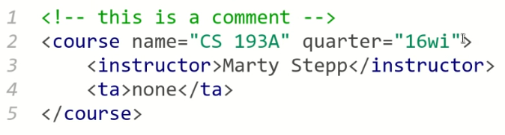
XML (eXtensible Markup Language)
XML : a language for describing hierarchical text data.
Uses tags that consist of element and attributes. Tags can be nested.
Some tag are opened and closed; others self closed.

Slide 8
Types of layout
Linear Layout
Relative Layout
Constraint Layout
Table Layout
Absolute Layout
Frame Layout
Grid Layout

Slide 9
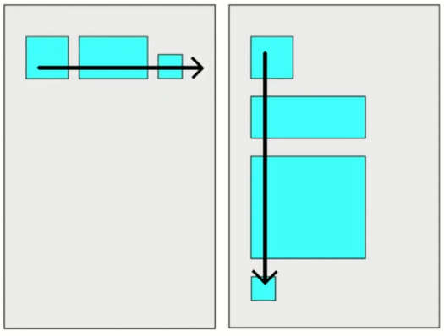
LinearLayout
Lays out views / widgets in a single line.
Orientation of horizontal or vertical.
Items do not wrap if they reach edge of screen.

Slide 10
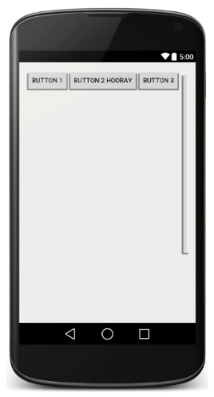
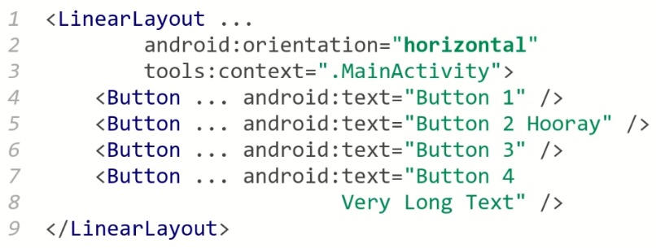
LinearLayout : Example

Slide 11
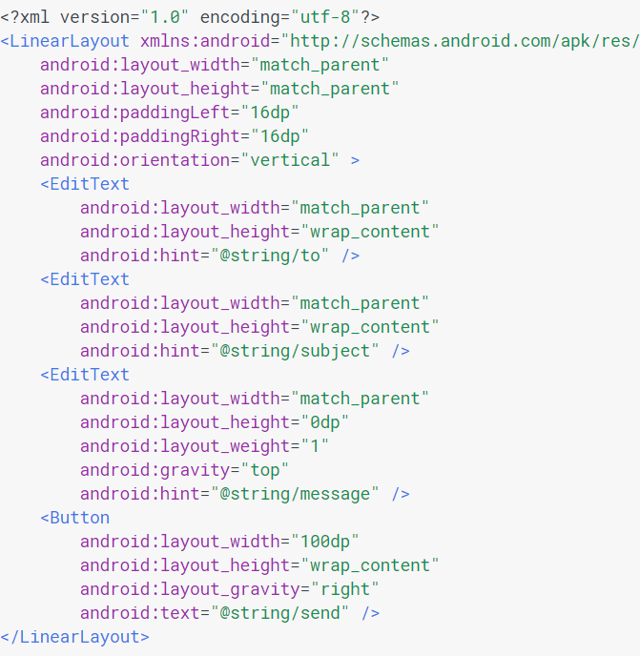
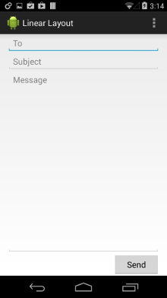
LinearLayout

Slide 12
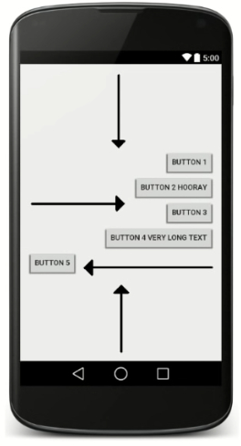
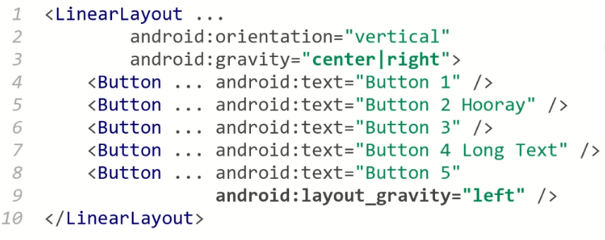
Gravity
Gravity : alignment direction that widgets are pulled.
top , bottom , left , right , center
Combine multiple with |
Set gravity on the layout to adjust all widgets ;set
layout_gravity on an individual widget.

Slide 13
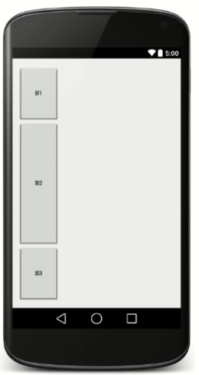
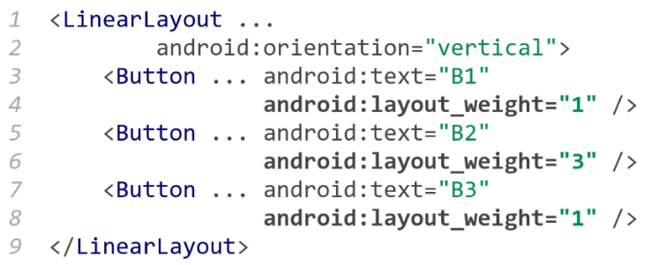
Weight
Weight : relative element sizes by integers
- Widget with weight k gets k/total fraction of total size.

Slide 14
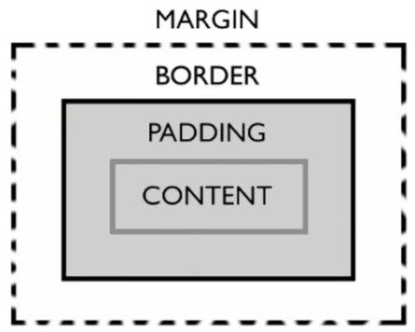
Widget box model
Content : size of widget itself.
Padding : artificial increase to widget size outside of content
Border : outside padding , a line around edge of widget
Margin : invisible separation from neighboring widget.

Slide 15
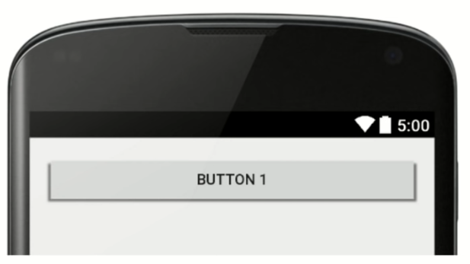
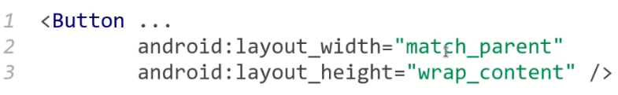
Sizing an individual widget
Width and height of a widget can be :
wrap_content : exactly large enough to fit the widget’s content.
match_parent : as wide or tall as 100% of the screen or layout.
A specified fixed width such as 64dp (not usually recommended)
dp : device pixel ; dip : device-independent pixel ; sp : scaling pixels.

Slide 16
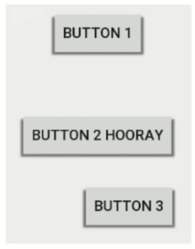
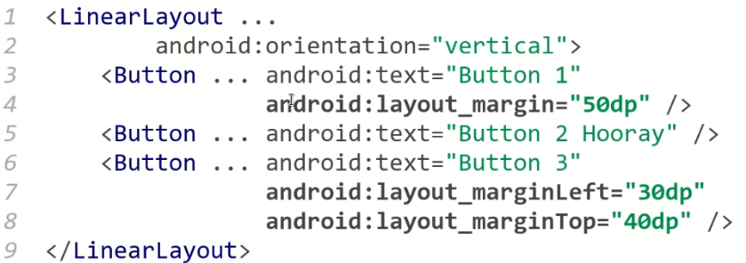
Margin
Extra blank space outside widget.
set layout_margin to adjust all sides;
layout_marginTop,Bottom,Left,Right

Slide 17
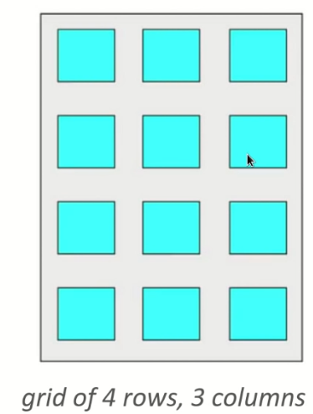
GridLayout
Lays out widgets / views in lines of rows and cols.
Orientation attribute defines row/column order
Introduces in Android 4; replaces older TableLayout.
Each widget placed into “next” available row/column
unless given layout_row and layout_column attribute.

Slide 18
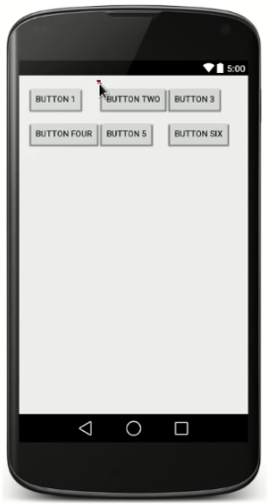
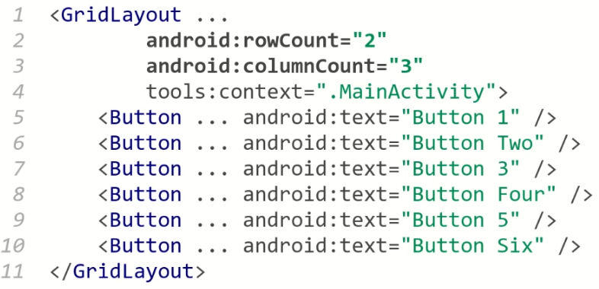
GridLayout : Example

Slide 19
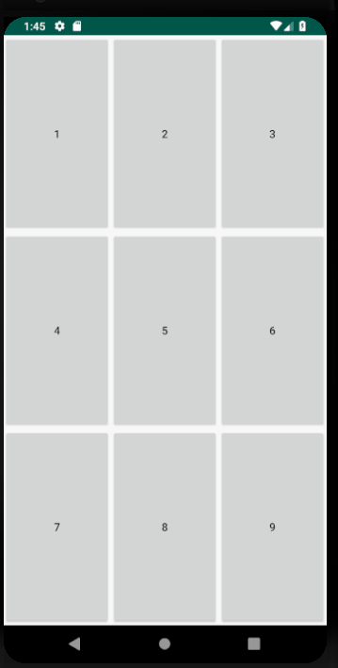
GridLayout : Exercise

Slide 20
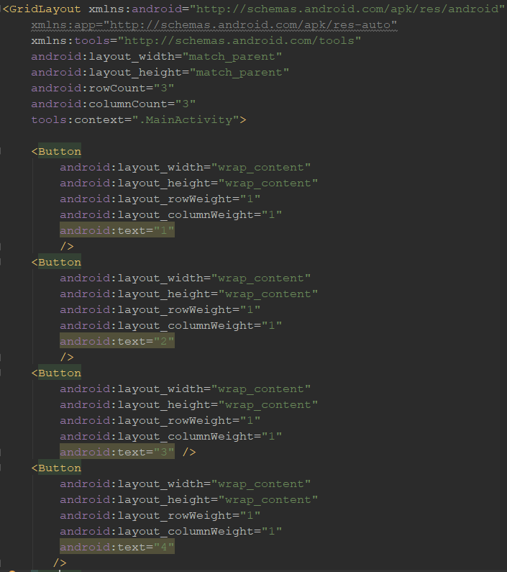
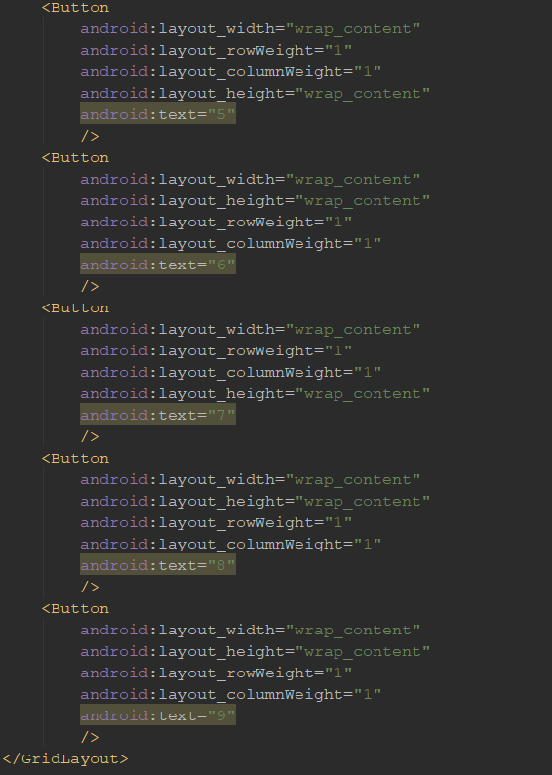
GridLayout : Solution

Slide 21
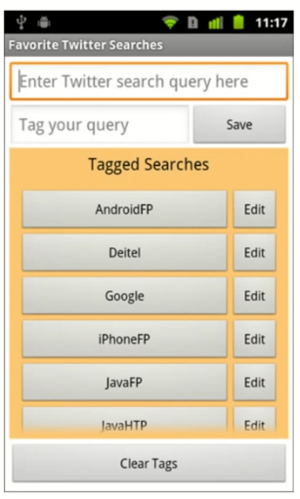
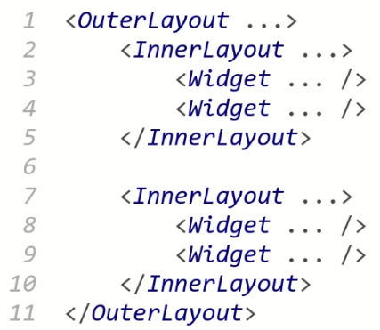
Nested Layout
Layout inside other layouts.
Used to produce more complicated layouts.

Slide 22
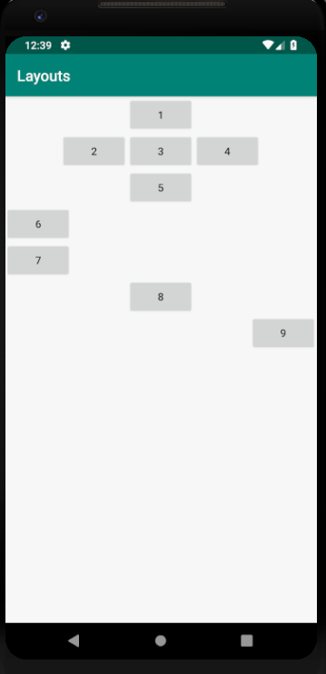
Nested Layout Exercise
Write the layout XML necessary to create the following app UI.
How many overall layouts are needed ?
Which widget go into which layout ?

Slide 23
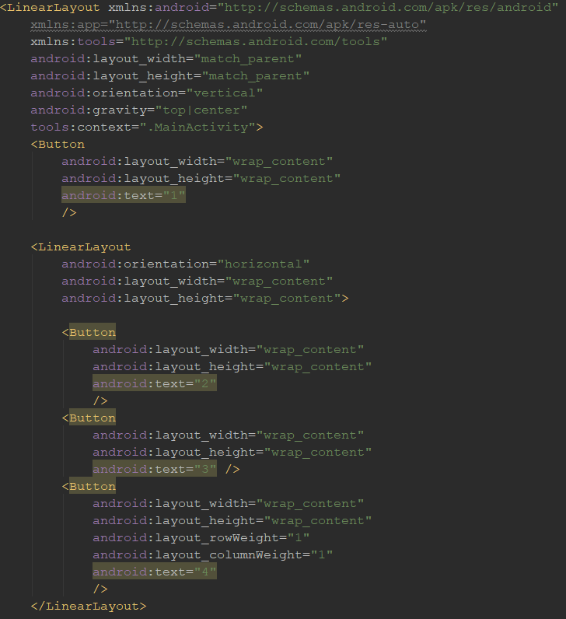
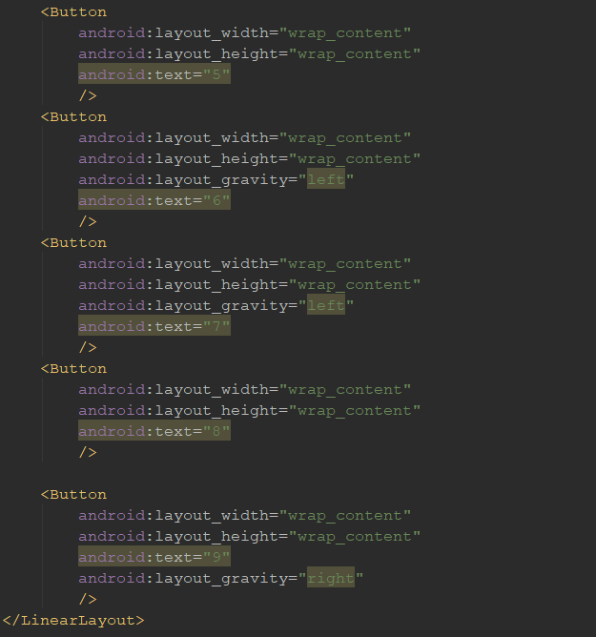
Solution

Slide 24
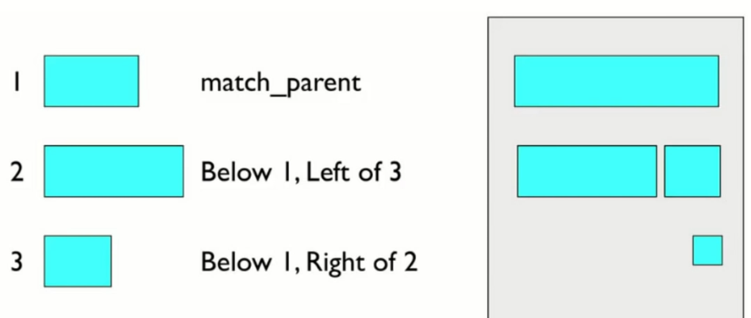
RelativeLayout
Intended to reduce the need for nested layouts
Each widget’s position and size are relative to each other views
relative to “parent” ( the activity itself).
relative to other widgets/views.
x-positions of reference : left , right , center.
y-positions of reference top , bottom , center.

Slide 25
Relative anchor points
Properties of x/y relative to another widget:
Layout_below , above,toLeftOf,toRightOf
Set these to the ID of another widget in the format “@id/ID” ( the given widget must have ID for this to work)
Properties for x/y relative to layout container (the activity) :
Layout_alignParentTop,Bottom,Left,Right
Set these flags to a Boolean value of “true” to enable them.
Layout_centerHorizontal,Vertical,InParent
Set these flags to “true” to center the control within its parent in a dimension

Slide 26
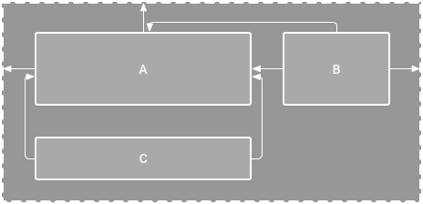
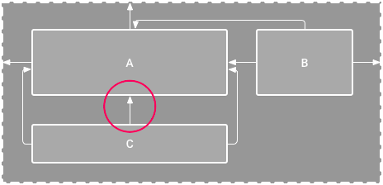
Constraint Layout
ConstraintLayout allows you to create large and complex layouts with a flat view hierarchy (no nested view groups). It's similar to RelativeLayout in that all views are laid out according to relationships between sibling views and the parent layout, but it's more flexible than RelativeLayout and easier to use with Android Studio's Layout Editor.

Slide 27
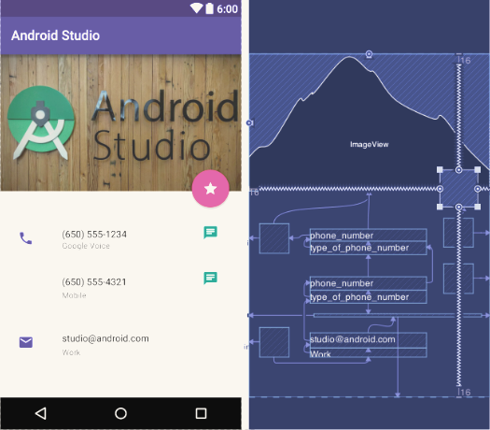
Constraint Layout

Slide 28
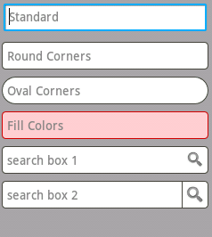
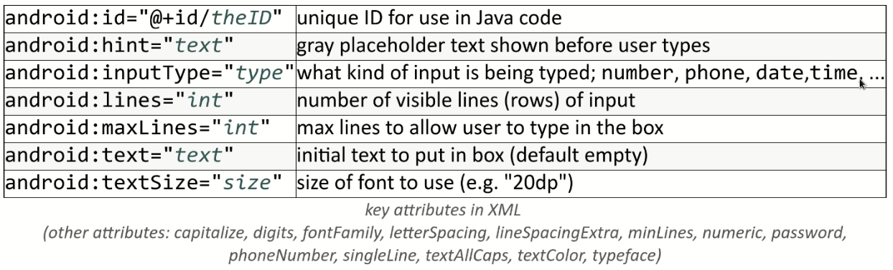
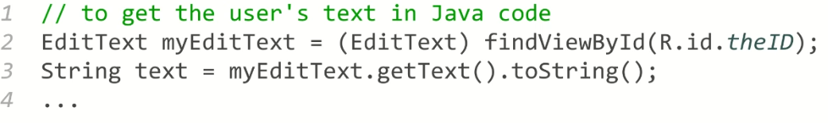
EditText
An editable text input box

Slide 29
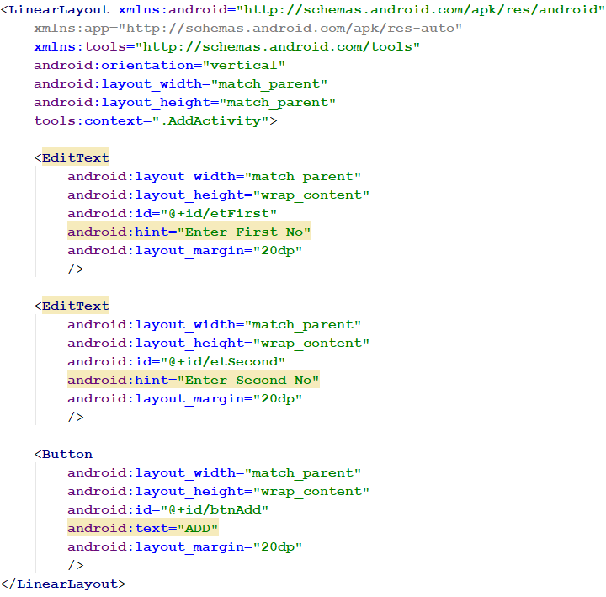
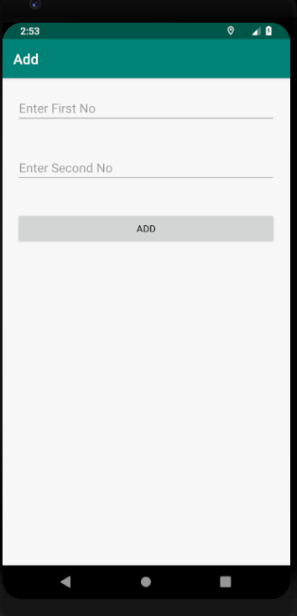
Hints

Slide 30
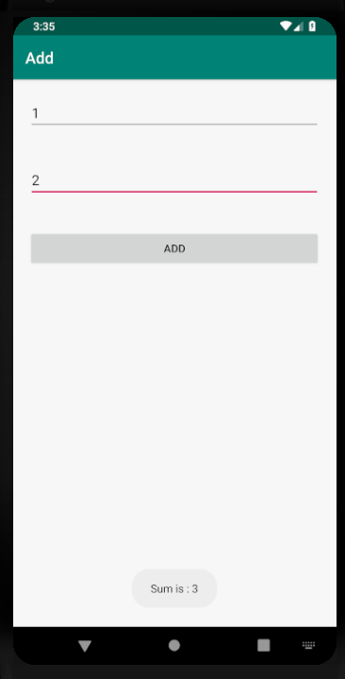
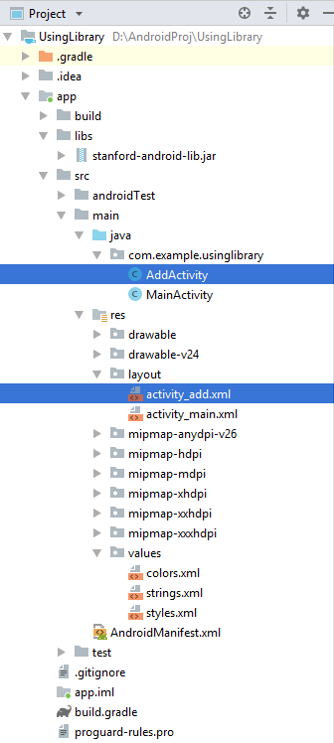
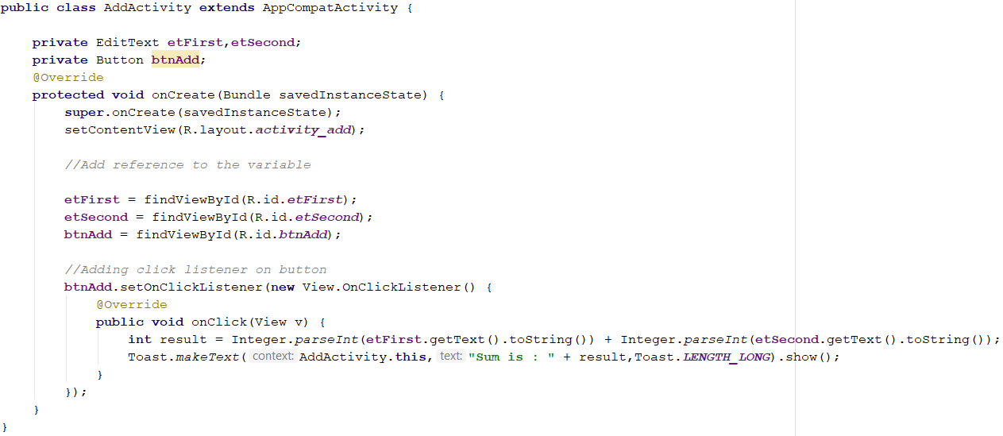
Java Code

Slide 31
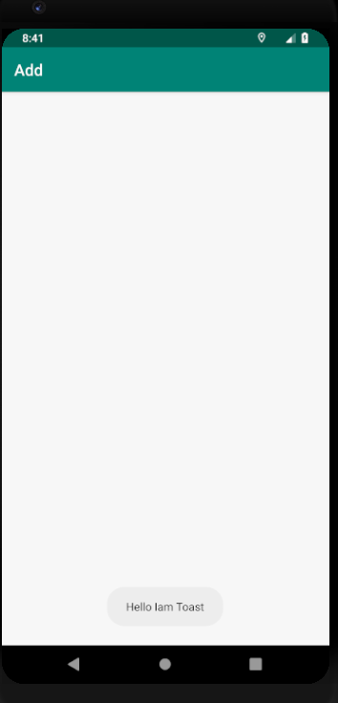
Toast
Android Toast can be used to display information for the short period of time.
A toast contains message to be displayed quickly and disappears after sometime.
The android.widget.Toast class is the subclass of java.lang.Object class.
You can also create custom toast as well for example toast displaying image.
You can visit next page to see the code for custom toast.
OR

Slide 32
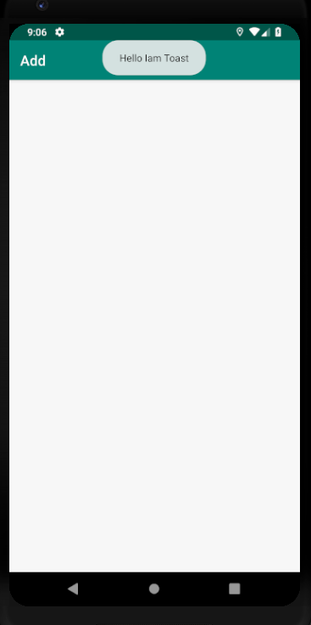
Positioning your Toast
A standard toast notification appears near the bottom of the screen, centered horizontally.
You can change this position with the method. This accepts
three parameters :
a Gravity constant.
an x-position offset
an y-position offset

Slide 33
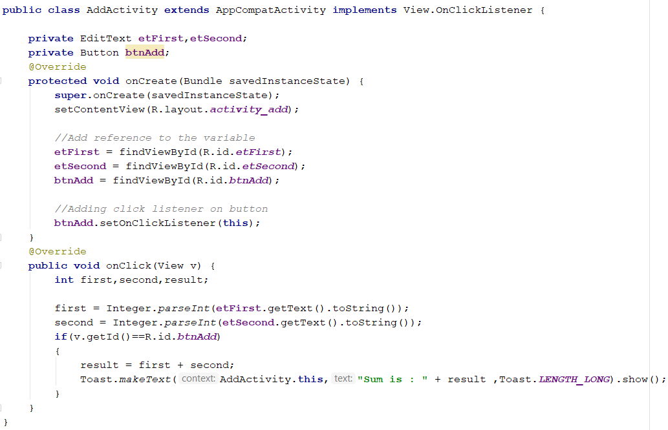
Click Event Using Interface

Slide 34
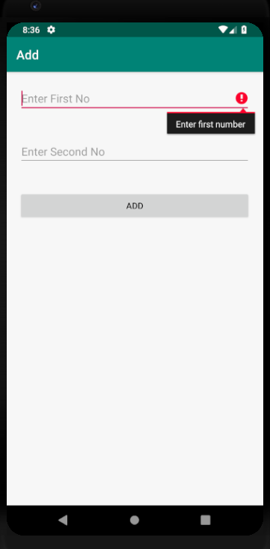
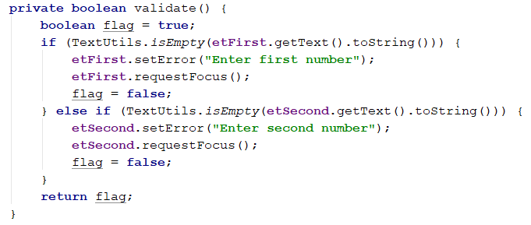
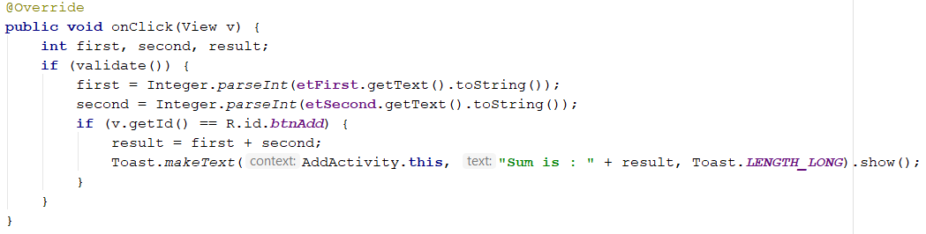
Validation in EditText

Slide 35



ScrollView
A container with scrollbars around anther widget or container

Slide 36

RadioButton and RadioButton Group
Radio buttons allow the user to select one option from a set.
You should use radio buttons for optional sets that are mutually exclusive if you think that the user needs to see all available options side-by-side. If it's not necessary to show all options side-by-side, use a spinner instead.
To create each radio button option, create a Radio button in your layout.
However, because radio buttons are mutually exclusive, you must group them together inside a RadioGroup. By grouping them together, the system ensures that only one radio button can be selected at a time.

Slide 37


RadioButton : Example

Slide 38


RadioButton : Java code

Slide 39

Output

Slide 40


ImageView
ImageView is used to display an image file in application.

Slide 41


Example

Slide 42



Code

Slide 43

Resources
In the project directory structure :
res/type/name.extension
Example : res/drawable/Pikachu.png
Referring to a resource , in the XML :
@type/name
Example : @drawable/pikachu
Referring to a resource ID , in the java code
R.type.name
Example : R.Drawable.pikachu

Slide 44



ImageButton
A clickable widget with an image label

